Slide 1

DataEthics4All Summer 2023 Cohort
AI & Data with an Ethics 1st Perspective
Founder: Shilpi Agarwal
Mentor & Cohort Content Developer Helper: Juliana Shihadeh

Slide 2
Table of Contents
Introduction
Background/Relevant Work
Methodology:
Data
Experiments
Results
Discussion
Conclusions/Future Work
What I Learned

Slide 3
Introduction
Siyona

Slide 4
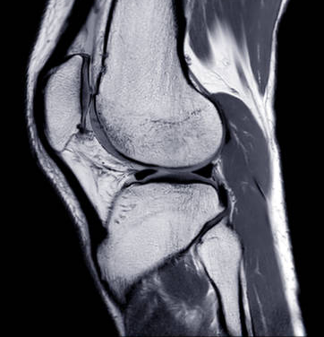
Goal & Overview
AI classification model
Classify MRI images of knees
based on ACL tear
healthy/unhealthy
Used a K-means model
in Python
Notes:
The goal of this project was to create a successful AI model that could classify an MRI image of a knee as healthy or not. A quick overview is that this project introduces an AI classification model for knee diagnostics. The model will intake MRI images of knees and determine if there was an ACL tear or not. It will then classify if the knee is healthy or unhealthy. We used a k-means model to accomplish this, which we coded through Python.

Slide 5
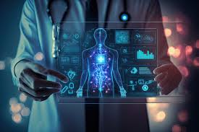
Importance of the Project
Increased Industry Application
AI assisting doctors
Connecting tech to our lives
Supporting our future
Making developments will impact us
Notes:
So why is this project important to us. This is a hot area of interest, exploration, and research in the industry, on how AI can be used to assist doctors in diagnosis making.
Our generation is looking for new ways to connect technology to other aspects of our lives, including sports, academics, music, arts, and more. We know that tech will be part of our future and we want to help ensure that it will be used properly and for beneficial purposes. The use of AI in healthcare intrigued us because these are the tools that we will be utilizing in our future and in our careers. Machine learning and AI models that support doctors in their work are important developments that need to be made, and we want to make any contributions that we can.

Slide 6
Background & Relevant Work
Nicky

Slide 7
Responsibility
Important factors to consider when developing AI
ethics
software bugs
misidentification
overfitting
Ai Is Learning to “read Minds,” Paving the Way for Hands-Free VR ..., morganton.com/life-entertainment/nation-world/technology/ai-is-learning-to-read-minds-paving-the-way-for-hands-free-vr-experiences/video_19dca366-2111-5f8f-885e-37beae924773.html. Accessed 26 Aug. 2023.

Slide 8
AI in the Health Field
Previous attempts at using AI and MRI images
Interpreting brain waves
Failures of past attempts
Ai Is Learning to “read Minds,” Paving the Way for Hands-Free VR ..., morganton.com/life-entertainment/nation-world/technology/ai-is-learning-to-read-minds-paving-the-way-for-hands-free-vr-experiences/video_19dca366-2111-5f8f-885e-37beae924773.html. Accessed 26 Aug. 2023.

Slide 9
Research Paper Background Sources
-Nicky
https://docs.google.com/document/d/1Qd5h_5Zy3meTMFBRNvFHVYb9_EglQIG0476JGOaSnUE/edit
Ai Is Learning to “read Minds,” Paving the Way for Hands-Free VR ..., morganton.com/life-entertainment/nation-world/technology/ai-is-learning-to-read-minds-paving-the-way-for-hands-free-vr-experiences/video_19dca366-2111-5f8f-885e-37beae924773.html. Accessed 26 Aug. 2023.

Slide 10
Methodology Overview
Dan

Slide 11
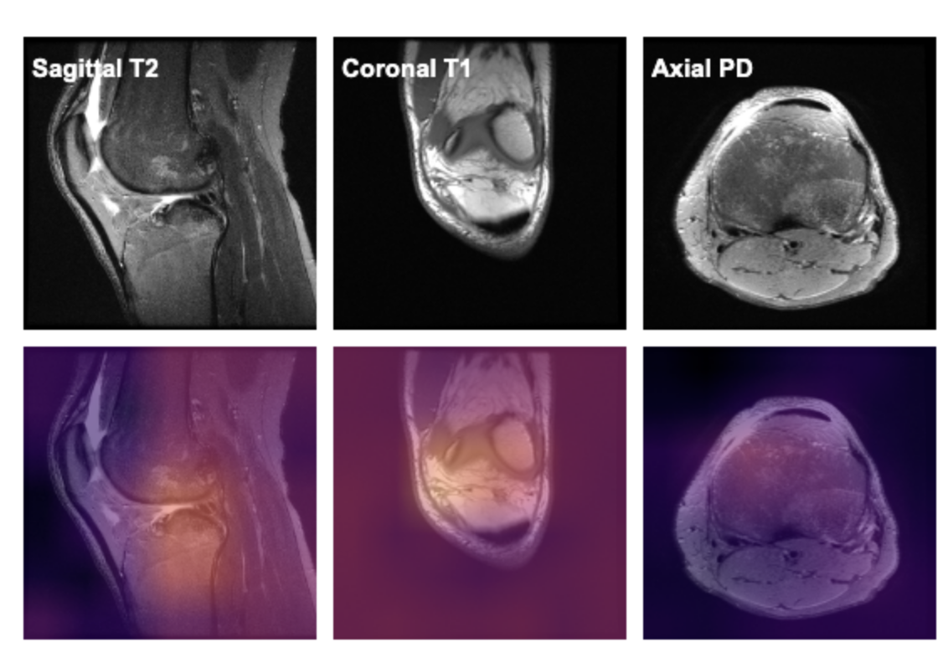
Dataset - Dan
The dataset we used is a set of MRI images of knees taken from multiple different angles
Classification of type of Knee Injury:
Abnormal, ACL tear, and meniscal tear
Our Project was on Classifying: ACL Tear Vs. No ACL Tear
Images for Multiple Angles of the Knee: 3 Total
Each focus on a set:
Axial
Coronal
Sagittal
https://stanfordmlgroup.github.io/projects/mrnet/

Slide 12
Process- Dan
Model was trained using Scikit-Learn’s K-means model
Determining center point
Assigning other points to one of these points which creates clusters
In our case, we had two separate clusters: with or without an ACL tear
The data was split into two separate groups:
400 images for training and 100 images for validation
After training the model, accuracy is calculated by comparing the list of predictions from the algorithm and a list with the actual categorization

Slide 13
Methodology: A Closer Look
-Julia

Slide 14
Training & Validation Split
Pixel values were drawn from 80% of the knee image data to be used as training data
The other 20% was set aside as validation data to later be used to test the model
80%
20%

Slide 15
Training the Model
Model: KMeans
KMeans is a clustering algorithm.
It generates clusters based off of means that it selects from data it is given
Keeps updating the means until the values stop changing
This is called the training phase of the model
You input to the model the desired number of clusters
The number of clusters is dependent on the number of classes in the data.
Using the training data it was given, the KMeans model created two clusters
Each Cluster represents a mean value for the pixels of the images
Ideally, the clusters should only have images that are similar to each other
We would see this by little overlap in the graph of the clusters

Slide 16
Validating the Model
A training accuracy is calculated
Then the KMeans model should be tested with the validation data that was set aside to evaluate how well it can classify data it has never seen before
The model classification of the validation data to a cluster should be compared with the actual label of each validation data point
A validation accuracy percent would then be calculated

Slide 17
Results

Slide 18
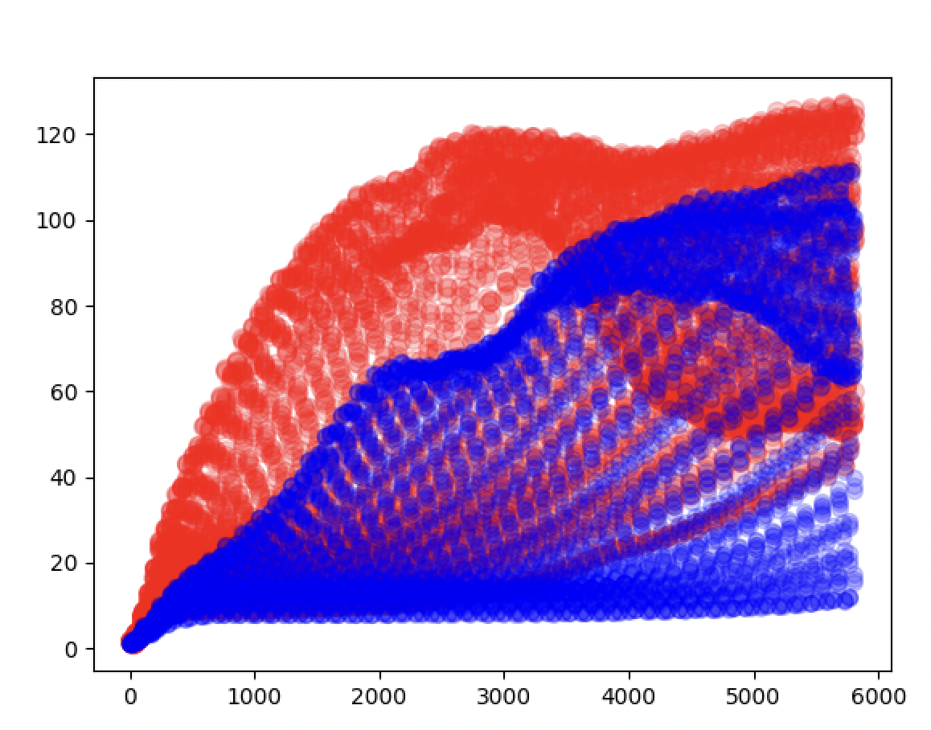
KMeans Model- Closest to Ideal
These parts of the clusters are not overlapping, as it can be seen by the colors
This means that the model is able to cluster these data points into the right group
These data points were easier for the model to classify then the ones in the middle
However, there is a lot of overlap overall, meaning that the model has a lot of room for improvement
Image Caption:
This figure is a graph that shows the final centers of Alexa’s KMeans model after it finished training. This should ideally be a complete split between the clusters.

Slide 19
Discussion & Conclusions - Alexa
We noticed how unbalanced the data ended up being and that’s something we should fix.
We didn’t get a lot of time with checking the accuracy.
Deep learning was brought up and it is definitely something we could experiment with..
We could add on to the code using the other data we were given.
Experiment with the different types of data.

Slide 20
Our Individual Learnings

Slide 21
Siyona
Different forms of AI
How they can help and harm
Ethical use of data
Data privacy and how it can be breached
Python basics
Designing a K-means model
Inputting data and plotting

Slide 22
Dan
Basic machine learning concepts
Manipulating data
Graphing data
Using python libraries for machine learning(scikit learn, numpy, matplotlib, etc)
Reading files using python
Manipulating multiple forms of data in Python
Text, images, numerical, musical, video
Usage of AI and its limitations
AI ethics

Slide 23
Alexa
Invasion of privacy when it comes to AI.
Collecting and analyzing data.
Limitations that AI should probably have.
Responsible AI and data use.
How AI can be very useful in daily life.
AI can be harmful if you have bad intentions and use it wrongfully.
Figured out how to use kmeans.
Learned how to plot data on python.
How to go through data using code/python.
I’ve created apps in the past, simple functioning ones of course, but now with the knowledge I gained from this cohort I will definitely explore into the AI world more and would look to implement AI into the apps I create in the future.

Slide 24
Nicky
Data Preprocessing
Python Basics
Overview of AI, ML, and data analytics
Python libraries (Numpy, Matplotlib, Pandas)

Slide 25
Julia
Uses of AI
AI is useful in a wide variety of fields including healthcare, finance, entertainment, and many more
AI also has diverse personal applications, for example many people know and use chatGPT
AI has applications to all of the following concepts: Data Science, Big Data, and Machine Learning
Data Science: involves breaking down data in order to discover patterns and uncover meaning
Big Data: deals with extremely large sets of data that require very advanced tools to break down (e.g. demographics, social media user interactions)
Machine Learning: the process of teaching computers to learn from data without being specifically programmed
AI fuels big data, machine learning, and data science by enabling data processing, learning, and insights extraction
There are several different types of data that you could have (called datatypes)
Image
Video
Numeric
Text
Although these are different data types, they all ultimately become represented and manipulated as numbers when it comes to working with them on computers

